Slide 1

Text Editing
Spring Practicum
David Dube, Rachit Kakkar, Ryan Kellar, Max Bentley, Matthew Espinoza

Slide 2
Product Overview
Part 1

Slide 3
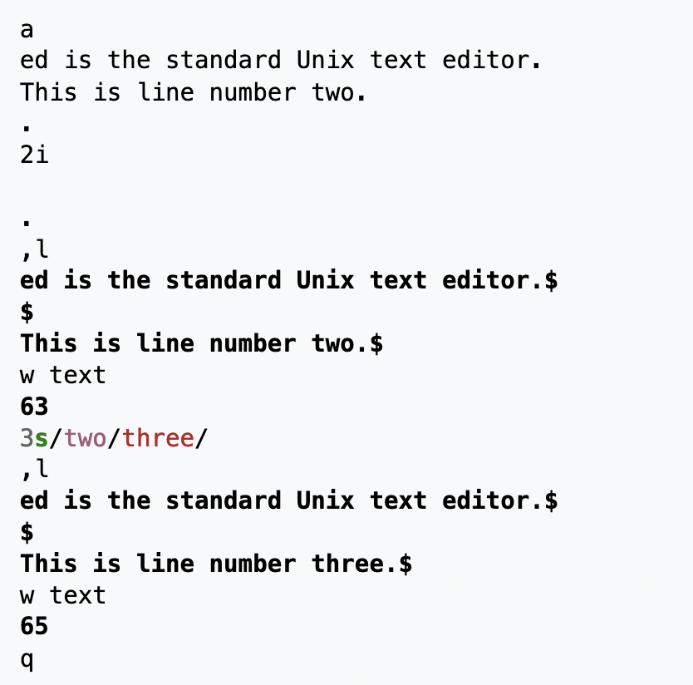
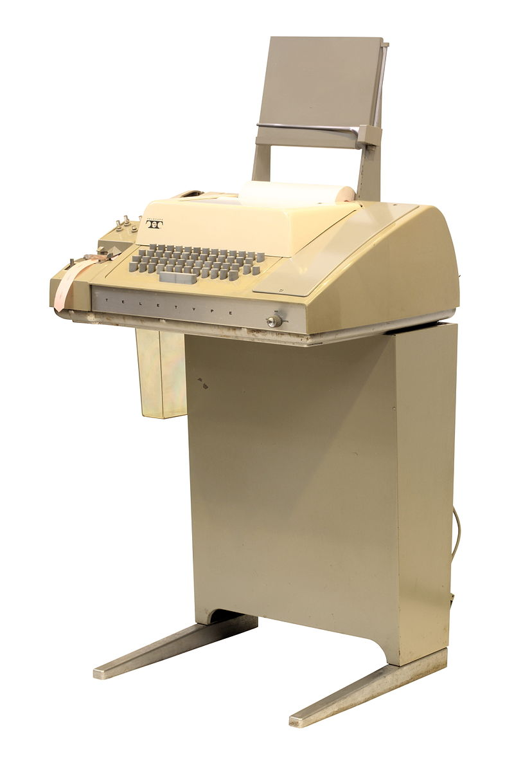
A Brief History
Ed (August 1969)
A line-oriented text editor
“standard Unix text editor”
Compatible with teletype terminals
Not display terminals
Notes:
Here is an example transcript of an ed session. For clarity, commands and text typed by the user are in normal face, and output from ed is emphasized
Works with display terminals, but designed for teletype terminals (in mind)

Slide 4
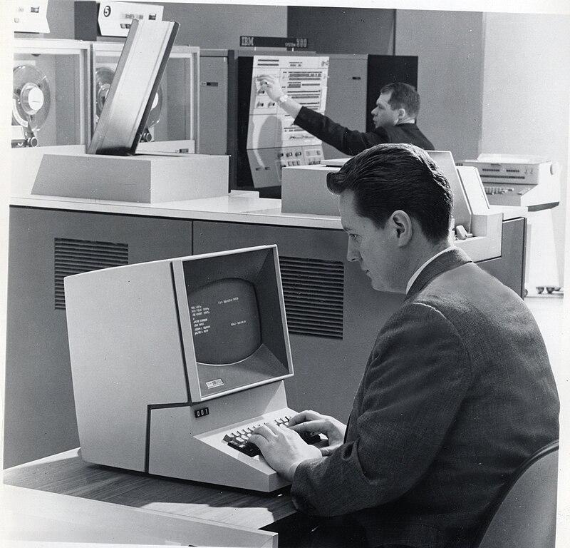

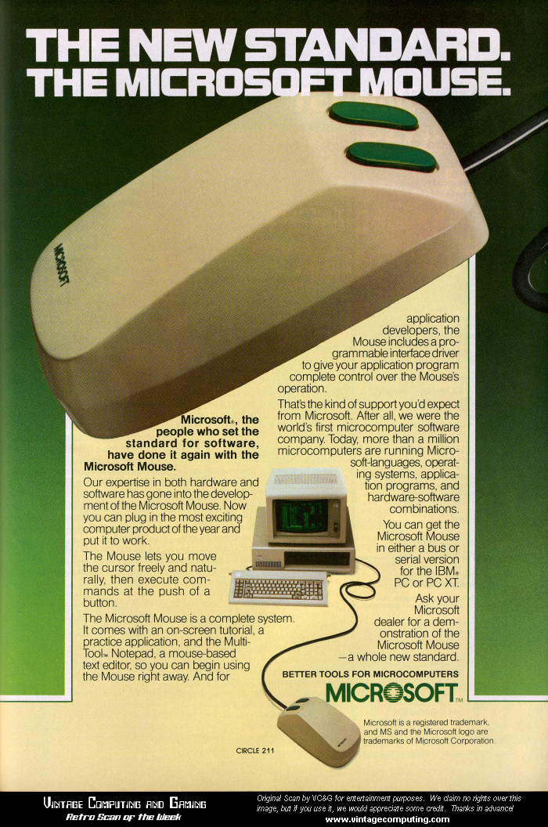

A Brief History
Vi/Vim (1976/1991) & Emacs (mid-1970s)
Screen-based
Designed to work in terminals
Random-access editing, WYSIWYG
Notepad (1983)
Also screen-based
GUI, designed to commercialize mouse
MS-DOS
KEY POINT: Users have come to expect a screen/file-based editing system following the WYSIWYG paradigm and allowing editing at any point!
GUI & mouse support is also nice to have among casual users
Notes:
Rachit

Slide 5





Components of A Usable Editor
Efficient insertion, deletion, and random access of text
Performance and memory trade offs between data structures
View variable amount of text (line width and count)
File Serialization
Read and write to files on disk
Usability: When scrolling, snap to end of line; New line on enter; Delete line on backspace; etc.
Advanced: find and replace, copy/cut and paste, text formatting, sentence highlighting, and etc.
Essentially, our user stories/audience needs!
Notes:
Demo w/ VS Code; Rachit

Slide 6






Development Tools
Clang++ - C++ compiler
GNU Make - Build system
Git/Github - Version control
Windows Subsystem for Linux - Cross-platform builds
Trello - Kanban & Project Management
ncurses - Text User-Interface

Slide 7
Product Demonstration
Features:
Insert and delete text
Cursor movement
Multi-line editing
Open files
Copy/Paste
Somewhat….

Slide 8
Key Algorithms
Part 2

Slide 9

Chosen Architecture for MVP
Gap Buffer
Represents a line of text
Linked list of gap buffers
Represents a file
Each entry is a line
Ncurses
User input
Render data to terminal
Modified stack for Undo/Redo

Slide 10
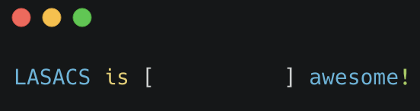
Gap Buffer
Gap Buffer
Initial state, cursor/gap between is and awesome
Left buffer
Gap
Right buffer
Notes:
Ryan Joke:
Why did the gap buffer break up with its text editor?
Because it couldn't handle the constant shifts in their relationship!

Slide 11
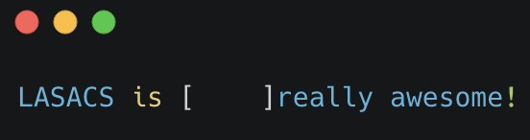
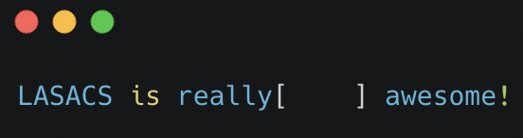
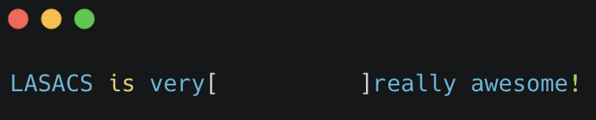
Gap Buffer
User moves the cursor before “really”. “really” is moved into the right buffer.
Initial state, cursor/gap between is and awesome
User inserts more text and fills the gap, so it is expanded. Expansion is O(n) as array is shifted.
User inserts text. This is O(1) as text moves directly into gap without having to shift char array
Bigger gap means fewer but more costly expansions
Notes:
Ryan Joke:
Why did the gap buffer break up with its text editor?
Because it couldn't handle the constant shifts in their relationship!

Slide 12
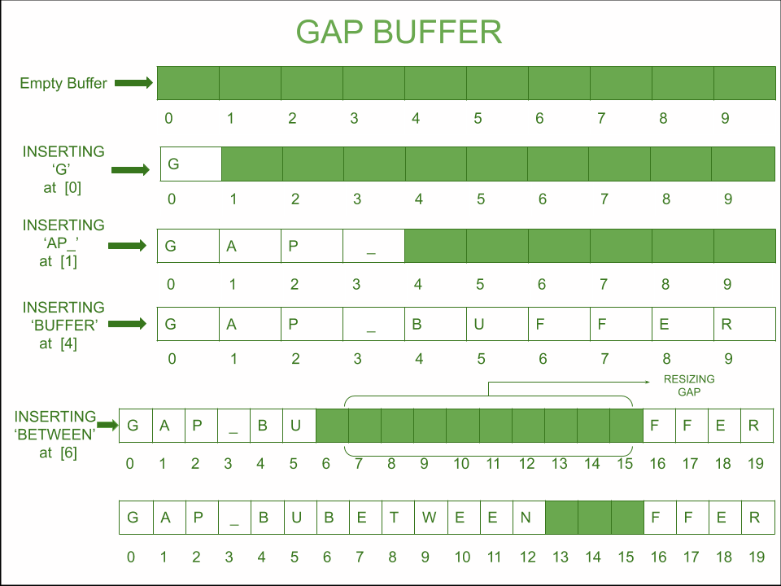
Gap Buffer
Advantages:
Efficient insertions and deletions near the gap
Compact representation
Disadvantages:
Inefficient for large edits away from the gap
Limited undo/redo capabilities
Notes:
Ryan Joke:
Why did the gap buffer break up with its text editor?
Because it couldn't handle the constant shifts in their relationship!

Slide 13
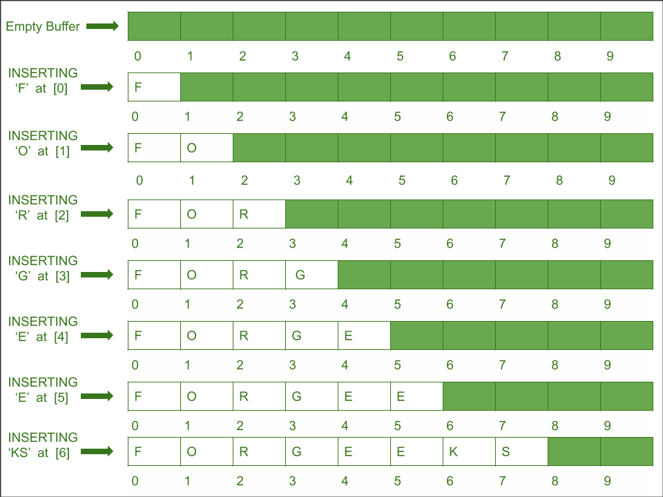
Gap Buffer
Use cases:
Editing and storing text such that the text can continue to be edited
Similar to an array, but has a gap inserted to manage editing at the cursor position
Insertion, deletion, and other operations that modify the core structure of the entire gap buffer, the gap responds accordingly to accommodate the change
Resizes the gap in the Gap Buffer!
Notes:
Ryan Joke:
Why did the gap buffer break up with its text editor?
Because it couldn't handle the constant shifts in their relationship!

Slide 14
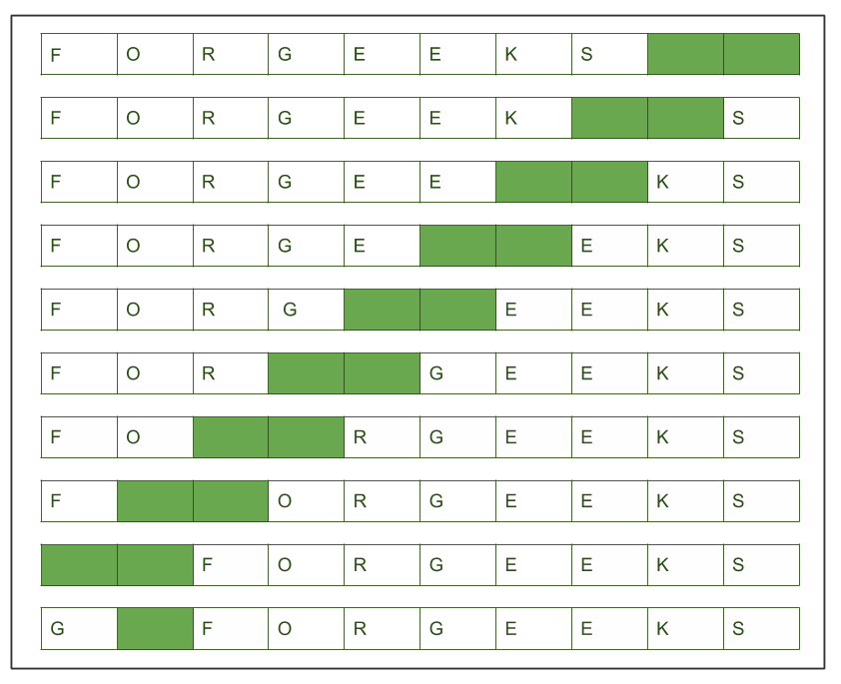
Gap Buffer
Gap Buffer
Movement of the cursor
Move the gap buffer along with the cursor to handle any insertion or deletion of text at the cursor position
Adjust the surroundings
Update the bounds of the surrounding left and right arrays
Works similar to a linked list in that the surrounding arrays are stored as integers like memory addresses, but not actually an address value
Notice how text on the left gets shifted to the right
The position of this O would be equal to gap_right, which is set to the integer 3
Notes:
Ryan Joke:
Why did the gap buffer break up with its text editor?
Because it couldn't handle the constant shifts in their relationship!

Slide 15
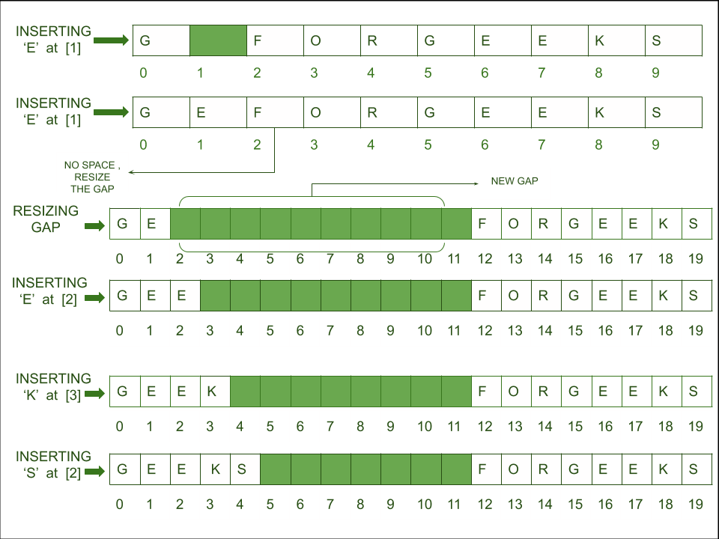
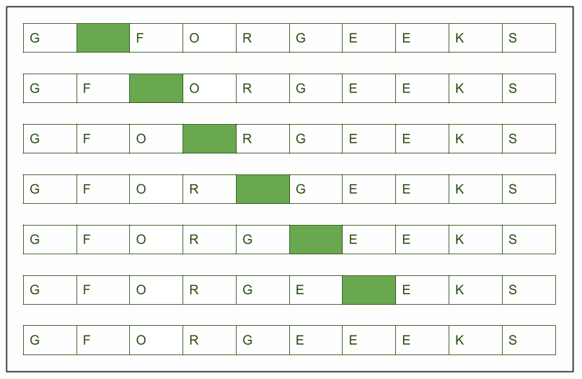
Gap Buffer
Gap Buffer
More on the movement of the cursor and gap…
The size of the gap shrinks as we add more text, sacrificing the size of the gap for the amount of text being displayed
Notes:
Ryan Joke:
Why did the gap buffer break up with its text editor?
Because it couldn't handle the constant shifts in their relationship!

Slide 16
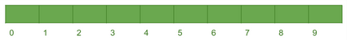

Linked List of Gap Buffers
Several advantages over one big gap buffer
Easier traversal between lines: just go to the next address
More memory-efficient: don't have to immediately allocate a large buffer at program start—instead, allocate memory dynamically
Clearer to understand in terms of multi-line editing
…

Slide 17
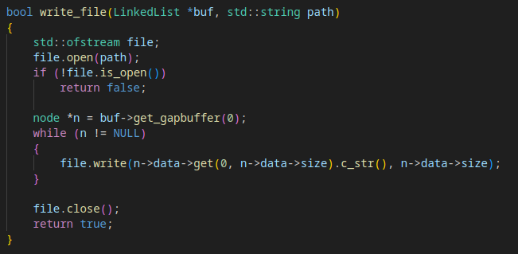
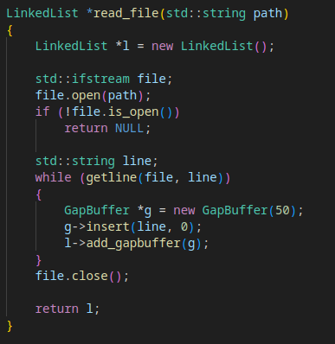
File Handling
Pretty simple
Text read and written line by line into linked list data structure

Slide 18
Undo/Redo: Overview
Users occasionally make mistakes
They should be able to undo these mistakes
All user actions must be undoable
Adding/removing text
Copy/pasting large amounts of text
Formatting text
Undoing an undo (redo)
Large undo history
Small increments
Automatic

Slide 19
Undo/Redo: Common Data Structures
Undo/Redo stack
Linked List
Tree??? (“This can be confusing and difficult” - Emacs documentation)
Our text editor settled on a stack for its simplicity
Both in implementation and user understanding

Slide 20
Undo/Redo Explanation
Undo/Redo Stack
File Contents
Lasa
{CS
]
is bad
} is good
INSERT “ is bad”
INSERT “]”
INSERT “} is good”
INSERT “{CS”
INSERT “Lasa”

Slide 21
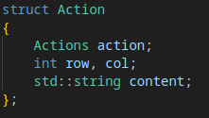
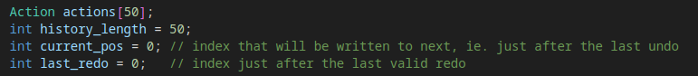
Undo/Redo: Code Structure
All modifications are done to the object representing a document
Undo actions are automatically added to the stack
Transparent to code outside the document object
New features can take advantage of undo/redo with no modification to existing code

Slide 22
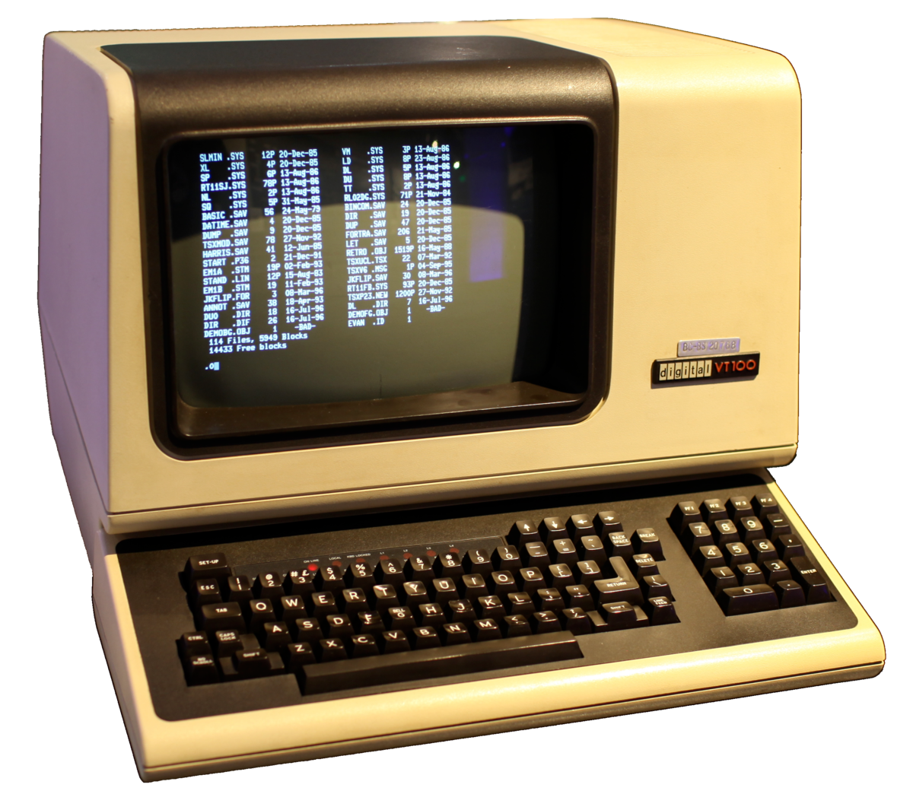

Render Buffer
In the past, terminals could be configured by sending a series of bytes
Example: echo "^[[0;31;40mIn Color"
The Curses library provides a wrapper over working with raw terminal codes
Text-based/terminal user interface (TUI)
Avoids complexity of GUI
Cross-platform
Notes:
In the past, terminals could be configured by sending a series of bytes
moving the cursor to a new location, erasing part of the screen, scrolling the screen, changing modes
Example: echo "^[[0;31;40mIn Color"
The Curses library provides a wrapper over working with raw terminal codes
functions to move the cursor, create windows, produce colors, play with mouse etc.
Text-based/terminal user interface (TUI)
Avoids complexity of GUI
Cross-platform

Slide 23
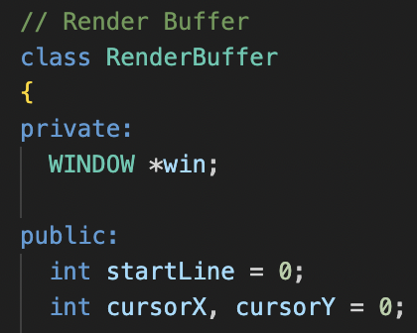
Render Buffer
s
Pointer to default window/terminal
Y-position of the first line (vertical scrolling)
Cursor position

Slide 24
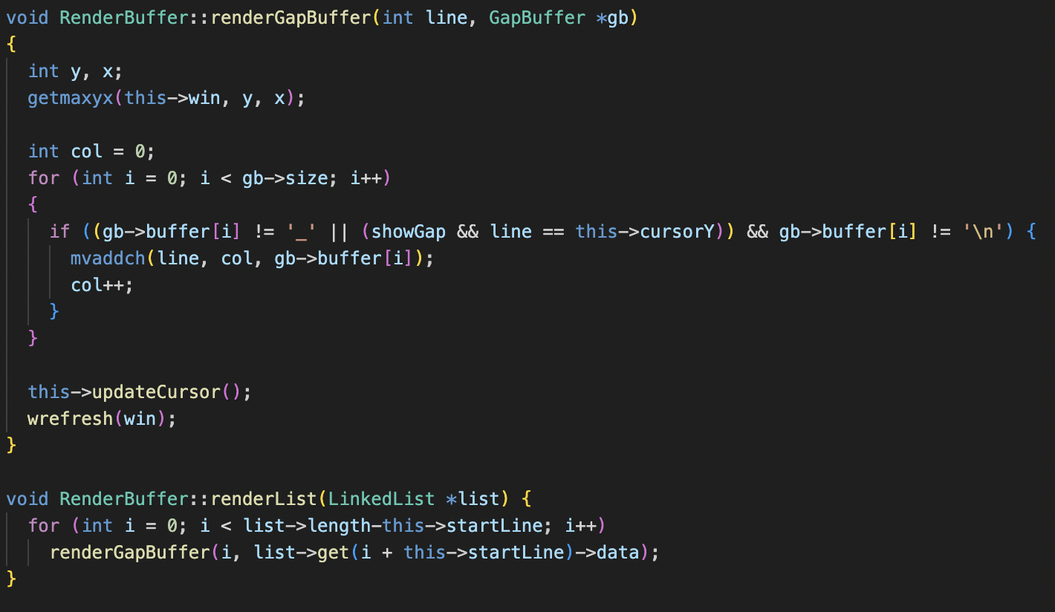
Render Buffer
Draw a gap buffer character by character at certain line (y-pos)
Move logical cursor to position; add character
Draw a linked list line by line (incrementing line number) bounded by starting line (scroll window)

Slide 25
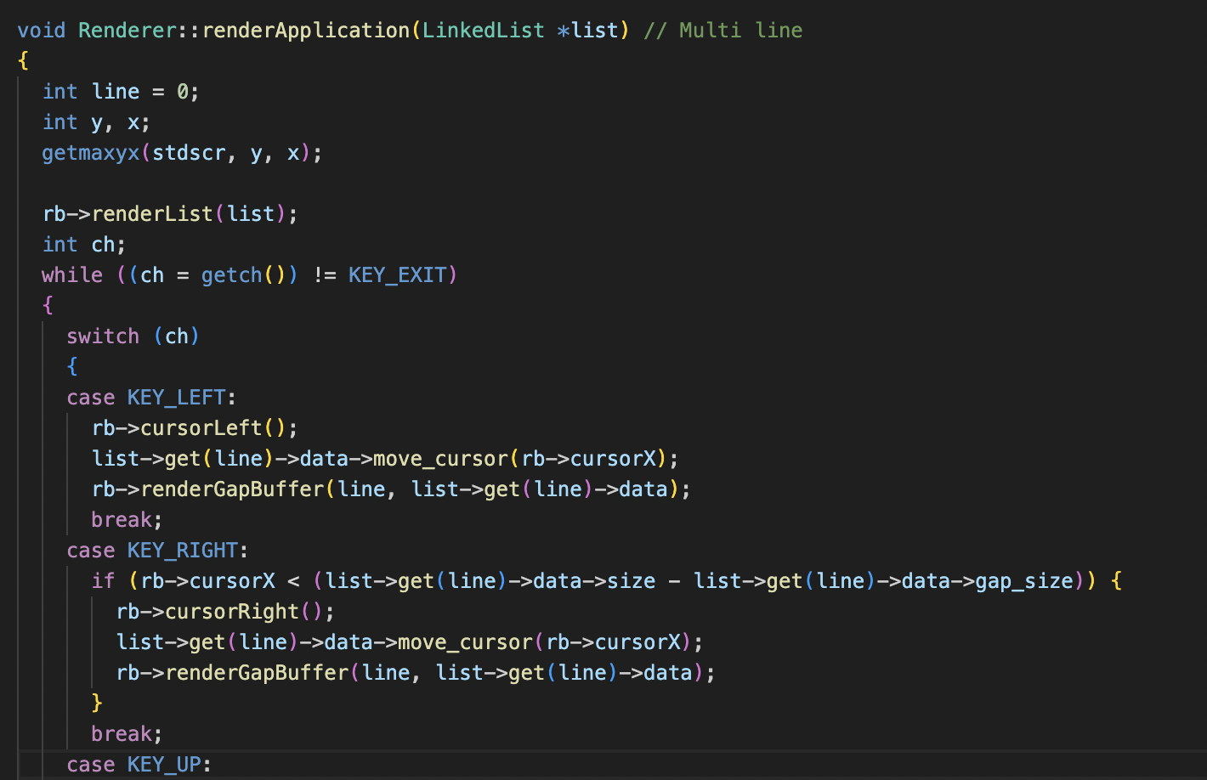
Render Buffer
Currently selected line is calculated from render buffer cursor y-position
Key press input with getch()
Move cursor of currently selected line/gap buffer (retrieved from linked list) with the render buffer
Re-render after user update
Notes:
Calculated on up and down

Slide 26
Burn Down
Part 3

Slide 27
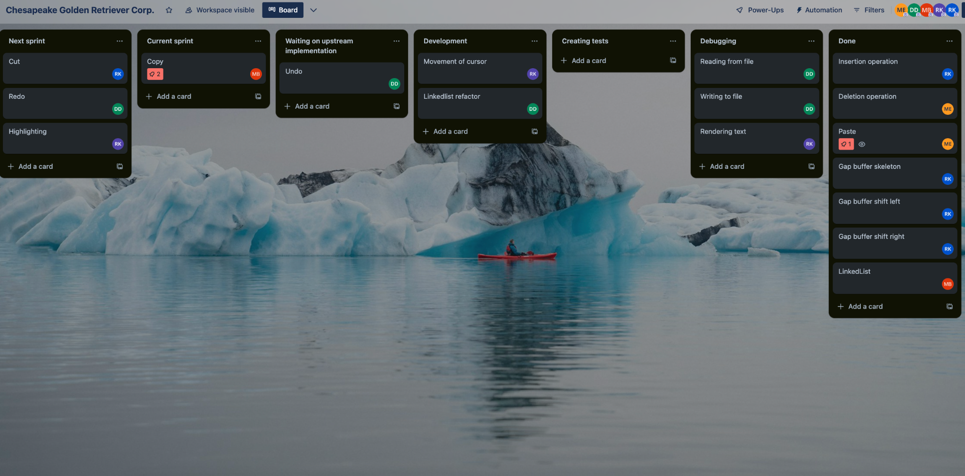
Kanban Board

Slide 28
Kanban Board
Assignment of Tasks
Prioritized input from team members for assigning tasks
Tasks were given to people based on their interests
Optimized tasks breakdown for the burndown chart
Larger tasks were broken down into smaller ones
Smaller tasks that we knew would take less time were combined into a single bigger task and assigned to a member
Dynamic Task Flow
When some team members were assigned to tasks that required the implementation of other tasks, we re-assigned them to tasks that could be completed at the current moment
This allowed us to maximize productivity among the team members and allowed everyone to participate in the scrum meetings and follow agile scrum principles by having an update on their progress

Slide 29
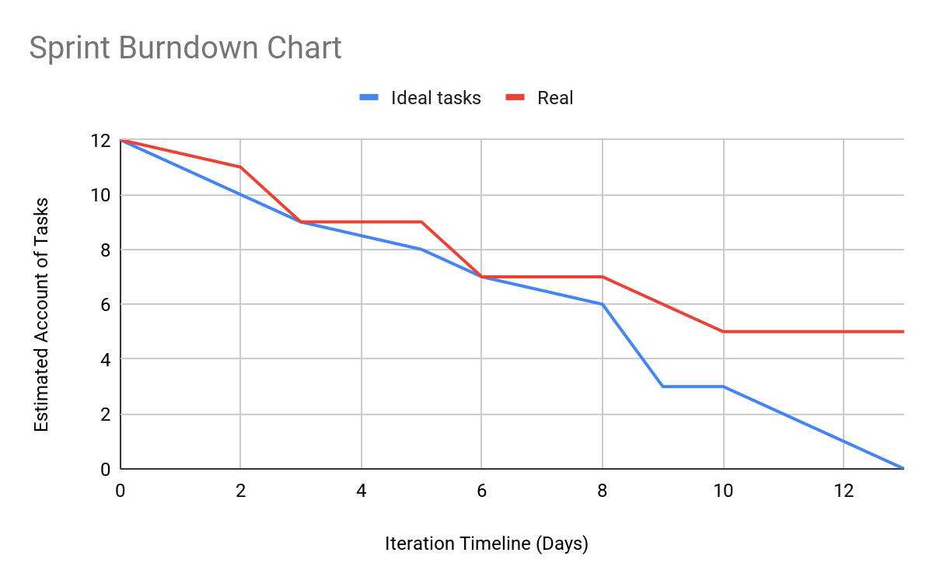
Burndown Chart

Slide 30
Burndown
Average Task Completion Time: ~5 ½ days
Tasks that took significantly longer than average:
Rendering text and multi-line editing
Issues with rendering were assumed to be with broken gap buffer implementation
Only when issues with the gap buffer were fixed did we uncover the issues with render buffer
Relatively short turnaround (~2 days)

Slide 31
Specifics
We did not achieve a MVP due to the five ongoing tasks left to complete :(
Rendering text (ncurses)
Linked List implementation
Insertion (Gap Buffer data structure)
Deletion (Gap Buffer data structure)
Movement of cursor (Gap Buffer data structure)
File serialization
Copy
Paste
Cut
Undo
Redo
Multi-line editing
7 days
2 days
6 days
6 days
3 days
3 days
Ongoing
Ongoing
Ongoing
Ongoing
Ongoing
9 days

Slide 32
Retrospective
Part 4

Slide 33
Challenges
Challenge 1: Coordination of tasks seemed disorganized
Ex: Features of the gap buffer were split among multiple people (such as insertion and movement)
Downtime while we were waiting for a basic gap buffer structure to be implemented
Ex: Did not plan how the gap buffer would integrate with the render buffer in a complete way
What should the render buffer do when the gap buffer text overflows the width of the terminal window? Horizontal scrolling? Text wrap?
Who controls movement of gap buffer and render buffer cursor?
Challenge 2: Implementation of features was clunky, largely due to failure to get changes working and integrated
Ex: Team members were implementing copy/cut/paste, undo, and rendering on different branches and failed to get a working MVP integrating all of these features
Most of these tasks are ongoing
Challenge 3: Lack of technical understanding and research before undertaking tasks
Ex: Failure to understand efficient use of ncurses
Resulted in hacks such as clearing the screen and repainting every new input/update
SLOW, CAUSES FLICKERING
Ex: Failure to understand scope of work needed to implement copy/paste

Slide 34

Successful Strategies
Strategy 1: Finish tasks that were integral for other methods to work.
Ex: finishing up the skeleton of the gap buffer so that implementing methods could be done
There was no down time on waiting after key components were finished
Strategy 2: Setting and communicating up SMART Goals
Examples of questions we asked: Was the copy method Specific? Was it Measurable? Was it Achievable? Was it Relevant to a text editor? Did we have enough time to complete?
As a direct result, we steered off methods that were unnecessary and tedious to complete, such as the cut method
Prioritized basics
Class time was invaluable for discussions on prioritizing tasks
Allowed quick pivots from original plan
Ex: Render Application class to coordinate data structures and render buffer, taking input
Strategy 3: Parallel development
Ex: Separate branches for copy/paste, undo, and rendering
Mostly unrelated, no need to stop development to wait for completion of tasks
MINOR CON: divergent Git histories, harder integration
Could be resolved with more foresight (planning branches ahead), communication, and more time to integrate

Slide 35
Unsuccessful Strategies
Unsuccessful Strategy 1: Unproductive Discussions
Ex: Initial arguments on whether to use the rope data structure
Simply performing SMART analysis would answer the question quickly
Doing so was impossible with time allotted
Ex: Wasting >30 minutes on debating that a string is a valid way to incorporate a gap buffer
Unsuccessful Strategy 2: Lack of Communication on Important Tasks
Ex: Status of grow method for gap buffer (needed for file serialization) was unknown
Didn't know grow method was unsuccessful until days later, causing a massive downtime in waiting for grow method to be finished
Ex: Work between branches was relatively unknown
Resulted in a lack of effort to integrate undo/redo
Ex: Failure to complete project proposal on time
Task was brought up, but quickly forgotten due to lack of consistent communication
Only one member completed on time

Slide 36
Further Planning
Part 5

Slide 37
What Remains?
To achieve a MVP:
Undo/Redo
File saving
Deletion and insertion of lines
Using our burn down chart, we estimate that it would take us approximately 3.5 more days to polish up our first minimum viable product.

Slide 38
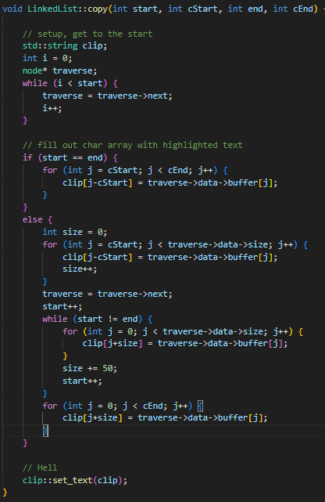

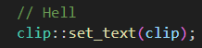
Copy
MUCH more complicated than expected
Began in sprint 2
Most of the operation itself is simple
Traverse through the linked list, adding to a string as you go along
Complexity lies in adding the string to the clipboard
Each OS has a different clipboard
Linux has X11 by default, Windows has something else (shocker)
There is a cross-platform library called Clip, but it doesn't lend itself well to our workflow
Simple implementation…
…until you try to add text to the clipboard.

Slide 39
Copy Explanation
Placeholder string
S T R I N G
S
T
R
I
N
G
Clipboard library
Clipboard (somewhere else in memory determined by clipboard manager)

Slide 40
BUT!
Terminal has built-in copy/paste features
Works with ncurses input
Makes paste unnecessary to implement
No default way to cut, so copy code is still useful in the future, even if it's not necessary for our first MVP
Did not know this until the bulk of both the copy and paste methods had been finished, so we just kept going and worked on both like usual

Slide 41
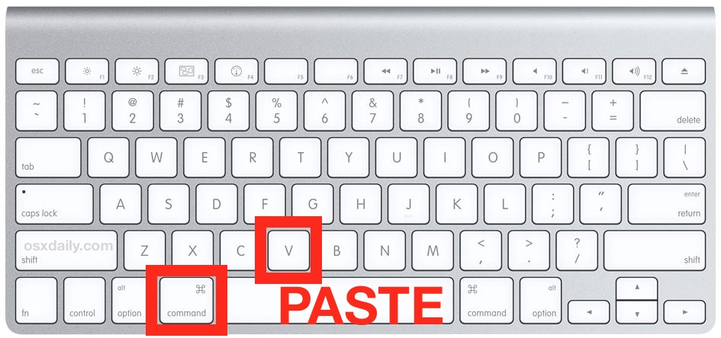
Paste
Pasting the value that is imported in
Possibly incorporate a clipboard that is used by copy and cut.
Insert string into gap buffer, it will eventually increase the gap buffer (no new row is created)
Method:
Transverse through string, taking each element
"Pasting" the element onto the gap buffer
Troubles:
Coupling with Copy
Though we had ideas to incorporate paste with copy, we ultimately couldn't because of the issues faced as stated before

Slide 42
String (clipboard)
*In theory
S T R I N G
H | E | L | L | O | _ | _ | _ | _ | _
H | E | L | L | O | S | T | _ | _ | _
H | E | L | L | O | S | T | R | _ | _
H | E | L | L | O | S | T | R | I | N
H | E | L | L | O | S | T | R | I | _
H | E | L | L | O | S | T | R | I | N | G | _ | _ | _ | _ | _

Slide 43
Cut
Very similar to copy
Instead of just copying the selected text to the clipboard, the cut method also deletes the text from the gap buffer
Essentially just a reverse paste: go from the back position to the front position, removing characters as you go along after adding the desired string to the clipboard

Slide 44
Conclusion
Learned importance of communication, further technical research, and SMART analysis in setting tasks and architecting project
Roughly 7/12 tasks completed, though many bugs remain
Goals likely were too ambitious considering busy EOY schedule
For a Hypothetical Version 2 MVP:
Cross-platform copy, paste and cut functions
Mouse support
Syntax highlighting
GUI implementation
Open multiple files/File browser
Autosave
Rope data structure?

